Slide 1
Angular Line of Business Apps Hands On
Deborah Kurata
Jerry Kurata
Consultants | Developers | Mentors
deborahk@insteptech.com jerryk@insteptech.com
Notes:
"An Angular application often displays a view for each of the many business operations including selection, review, and editing. And as soon as you have more than one view, you need a way to navigate between them. This session demonstrates how to define, configure, and navigate Angular routes to display multiple views. First, we look at the available routing frameworks: ngRoute and UI Router, each with their own approach to routing. Then we dive deeper with step-by-step demonstrations of implementing routing based on application state."

Slide 2
Deborah Kurata
Independent Consultant | Developer | Mentor
Web (Angular), .NET
Pluralsight Author
AngularJS Line of Business Applications
Angular Front to Back with Web API
Object-Oriented Programming Fundamentals in C#
Microsoft MVP

Slide 3
Jerry Kurata
Independent Consultant | Developer | Mentor
Web (Angular), .NET
Internet of Things (IoT)
Big Data
Speaker

Slide 4
Rate Yourself on Angular
New to Angular - no proficiency
Just starting out - limited proficiency
Doing it, not fully understanding it - working proficiency
Been there, done that, can help others - full proficiency

Slide 5

Overview
Basics
Navigation and Routing
Data Access
Forms and Validation

Slide 6
Hands On Labs
After the topic has been presented
Starter files provided
Minimize excess typing
Detailed instructions provided
With the "answer" to use as needed
Extra Tasks
If time permits

Slide 7
BASICS

Slide 8
Overview - Basics
Introduction to Angular
Angular and HTML: Building a View
Data Binding
Angular Code: Building the Module & Controller
Bootstrap: Styling the View

Slide 9

A client-side JavaScript framework for building interactive Web applications
Brings simple/clean back to complex Web apps
Originally developed by Google
Now open source: https://angularjs.org/

Slide 10



Web Browser
Web Server
URL Request (www.mysite.com)
HTML
HTML
Response (Page and Assets)
Java-Script
Java-Script
HTTP Service
DB
Notes:
So, how does it work.
There are no "Angular" files per se.
Index.html by convention is the startup page.
It contains link and script tags with the paths to the required assets (HTML templates, JavaScript files, CSS files, etc)

Slide 11
Web Browser
Web Server
HTML
URL Request (www.mysite.com)
HTML
Response (Page and Assets)
Java-Script
Java-Script
(http://mysite/api/movies)
HTTP Service
Response
DB
Data

Slide 12
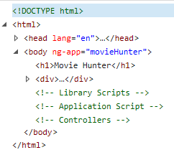
DOM
Document Object Model
Tree structure that defines all of the loaded elements in an HTML document

Slide 13
DEMO: Angular App
Notes:
Be sure to show:
Resizing (responsive design)
Filtering
Use F12 tools to show the communication with the server and the DOM.

Slide 14
Why Angular?
Expressive HTML
Powerful Data Binding
Modularity
Rule-based Navigation
Easily Call HTTP Service
Authoritative Forms
Testable
It's Popular

Slide 15
Movie List View
Expressive HTML
<div ng-controller="MovieListCtrl">
<div>{{title}}</div>
<div>Filter by:</div><input type="text" ng-model="listFilter" />
<div ng-show="listFilter">
<h3>Movies filtered by: {{listFilter}}</h3>
</div>
<table ng-if="movies.length">
<thead>
<tr>
<td><button type="button"
ng-click="toggleImage()">
{{showImage ? "Hide" : "Show"}} Poster
</button></td>
<td>Title</td> <td>Director</td> <td>Release Date</td> <td>Rating</td>
</tr>
</thead>
<tbody>
<tr ng-repeat="movie in movies | filter : {title:listFilter} | orderBy : 'title'">
<td><img ng-show="showImage"
ng-src="{{movie.imageurl}}" title="{{movie.title}}"></td>
<td>{{ movie.title}}</td>
<td>{{ movie.director }}</td>
<td>{{ movie.releaseDate | date }}</td>
<td>{{ movie.mpaa | uppercase}}</td>
</tr>
</tbody>
</table>
</div>

Slide 16
Directives
Expressive HTML
Extend HTML
Apply special behavior to attributes or elements in the HTML
Are simple to define in the HTML
Prefixed with "ng-"
Provide an extensive set of features and capabilities

Slide 17
Directives
<body ng-app="movieHunter">
<table ng-if="movies.length">
<tr ng-repeat="movie in movies | orderBy:'title' ">
<img ng-show="showImage"
ng-src="" />
<button type="button"
ng-click="toggleImage()">Poster
</button>

Slide 18
One Way Data Binding
Powerful Data Binding
View is a projection of the model
When the model changes, the view reflects the change
Binding Expression
{{movie.title}}

Slide 19
One Way Data Binding
<tr ng-repeat="movie in movies | orderBy:'title' ">
<td>
<img ng-show="showImage"
ng-src="{{movie.imageurl}}" />
</td>
<td>
<a>{{movie.title}}</a>
</td>
<td>{{movie.director}}</td>
<td>{{movie.date | date}}</td>
<td>{{movie.mpaa | uppercase}}</td>
</tr>

Slide 20
Two Way Data Binding
Powerful Data Binding
Data in the model and the view are synchronized
Changes to the model are reflected in the view
Changes in the view are reflected in the model
Define using a directive: ng-model
ng-model="listFilter"

Slide 21
Two Way Data Binding
<div>
<div>Filter by:</div>
<div>
<input type="text" ng-model="listFilter" />
</div>
</div>
<div ng-show="listFilter">
<h3>Movies filtered by: {{listFilter}}</h3>
</div>
<tr ng-repeat="movie in movies | orderBy:'title'
| filter : {title : listFilter}">

Slide 22
Directives and Binding
Directives
ng-app, ng-if, ng-repeat
ng-show/ng-hide
Data Binding
One way binding
{{movie.title}}
Two way binding
ng-model="listFilter"
Expressive HTML
Powerful Data Binding

Slide 23
Angular Code
Modularity
Write using
JavaScript
TypeScript
Divided into
Modules
Controllers
Services
Notes:
TypeScript
Class-based object-oriented
Strongly typed

Slide 24
Module
Defines an Angular component
Tracks the component code
Tracks the dependencies for the component
Keeps the application modularized

Slide 25
Angular Module Method
Setter Method
angular.module("movieHunter", ["ngRoute",
"common.services"]);
Getter Method
angular.module("movieHunter");

Slide 26
Angular Main Module
var app = angular.module("movieHunter",
[]);

Slide 27
Angular Main Module
function () {
var app = angular.module("movieHunter",
[]);
}

Slide 28
Angular Main Module - IIFE
(function () {
var app = angular.module("movieHunter",
[]);
}());

Slide 29
The IIFE JavaScript Pattern
Immediately-Invoked Function Expression
JavaScript var declarations have global scope
JavaScript variables and functions defined within a function have local scope
(function () {
// Code here
}());

Slide 30
Module
Modularity
One "main" module for the application
Any number of additional modules
Group related functionality
Define reusable common code

Slide 31
Controller
Defines the Model
Movies
Implements Methods
Hide/Show Images

Slide 32
View, Controller, and $scope
Angular Application (movieHunter)
movieListView
MovieListCtrl
<div ng-controller=
"MovieListCtrl">
$scope
Directives & Bindings
Model
</div>
Methods

Slide 33
Angular Controller
(function () {
"use strict";
angular
.module("movieHunter")
.controller("MovieListCtrl",
["$scope",
MovieListCtrl]);
function MovieListCtrl($scope) {
$scope.movies = [];
$scope.title = "Search by Movie Title";
$scope.showImage = false;
$scope.toggleImage = function () {
$scope.showImage = !$scope.showImage;
};
}());

Slide 34
Angular "Controller As" Syntax
(function () {
"use strict";
angular
.module("movieHunter")
.controller("MovieListCtrl",
["$scope",
MovieListCtrl]);
function MovieListCtrl($scope) {
$scope.movies = [];
$scope.title = "Search by Movie Title";
$scope.showImage = false;
$scope.toggleImage = function () {
$scope.showImage = !$scope.showImage;
};
}());

Slide 35
Angular "Controller As" Syntax
(function () {
"use strict";
angular
.module("movieHunter")
.controller("MovieListCtrl",
[MovieListCtrl]);
function MovieListCtrl() {
$scope.movies = [];
$scope.title = "Search by Movie Title";
$scope.showImage = false;
$scope.toggleImage = function () {
$scope.showImage = !$scope.showImage;
};
}());

Slide 36
Angular "Controller As" Syntax
(function () {
"use strict";
angular
.module("movieHunter")
.controller("MovieListCtrl",
[MovieListCtrl]);
function MovieListCtrl() {
var vm = this;
$scope.movies = [];
$scope.title = "Search by Movie Title";
$scope.showImage = false;
$scope.toggleImage = function () {
$scope.showImage = !$scope.showImage;
};
}());

Slide 37
Angular "Controller As" Syntax
(function () {
"use strict";
angular
.module("movieHunter")
.controller("MovieListCtrl",
[MovieListCtrl]);
function MovieListCtrl() {
var vm = this;
vm.movies = [];
vm.title = "Search by Movie Title";
vm.showImage = false;
vm.toggleImage = function () {
vm.showImage = !vm.showImage;
};
}());

Slide 38
View "Controller As" Syntax
<div ng-controller="MovieListCtrl">
<div>{{title}}</div>
<div>Filter by:</div><input type="text" ng-model="listFilter" />
<div ng-show="listFilter">
<h3>Movies filtered by: {{listFilter}}</h3>
</div>
<table ng-if="movies.length">
<thead>
<tr>
<td><button type="button"
ng-click="toggleImage()">
{{showImage ? "Hide" : "Show"}} Poster
</button></td>
<td>Title</td> <td>Director</td> <td>Release Date</td> <td>Rating</td>
</tr>
</thead>
<tbody>
<tr ng-repeat="movie in movies | filter : {title:listFilter} | orderBy : 'title'">
<td><img ng-show="showImage"
ng-src="{{movie.imageurl}}" title="{{movie.title}}"></td>
<td>{{ movie.title}}</td>
<td>{{ movie.director }}</td>
<td>{{ movie.releaseDate | date }}</td>
<td>{{ movie.mpaa | uppercase}}</td>
</tr>
</tbody>
</table>
</div>

Slide 39
View "Controller As" Syntax
<div ng-controller="MovieListCtrl as vm">
<div>{{title}}</div>
<div>Filter by:</div><input type="text" ng-model="listFilter" />
<div ng-show="listFilter">
<h3>Movies filtered by: {{listFilter}}</h3>
</div>
<table ng-if="movies.length">
<thead>
<tr>
<td><button type="button"
ng-click="toggleImage()">
{{showImage ? "Hide" : "Show"}} Poster
</button></td>
<td>Title</td> <td>Director</td> <td>Release Date</td> <td>Rating</td>
</tr>
</thead>
<tbody>
<tr ng-repeat="movie in movies | filter : {title:listFilter} | orderBy : 'title'">
<td><img ng-show="showImage"
ng-src="{{movie.imageurl}}" title="{{movie.title}}"></td>
<td>{{ movie.title}}</td>
<td>{{ movie.director }}</td>
<td>{{ movie.releaseDate | date }}</td>
<td>{{ movie.mpaa | uppercase}}</td>
</tr>
</tbody>
</table>
</div>
Notes:
ALIAS

Slide 40
View "Controller As" Syntax
<div ng-controller="MovieListCtrl as vm">
<div>{{vm.title}}</div>
<div>Filter by:</div><input type="text" ng-model="listFilter" />
<div ng-show="listFilter">
<h3>Movies filtered by: {{listFilter}}</h3>
</div>
<table ng-if="vm.movies.length">
<thead>
<tr>
<td><button type="button"
ng-click="vm.toggleImage()">
{{vm.showImage ? "Hide" : "Show"}} Poster
</button></td>
<td>Title</td> <td>Director</td> <td>Release Date</td> <td>Rating</td>
</tr>
</thead>
<tbody>
<tr ng-repeat="movie in vm.movies | filter : {title:listFilter} | orderBy : 'title'">
<td><img ng-show="vm.showImage"
ng-src="{{movie.imageurl}}" title="{{movie.title}}"></td>
<td>{{ movie.title}}</td>
<td>{{ movie.director }}</td>
<td>{{ movie.releaseDate | date }}</td>
<td>{{ movie.mpaa | uppercase}}</td>
</tr>
</tbody>
</table>
</div>

Slide 41
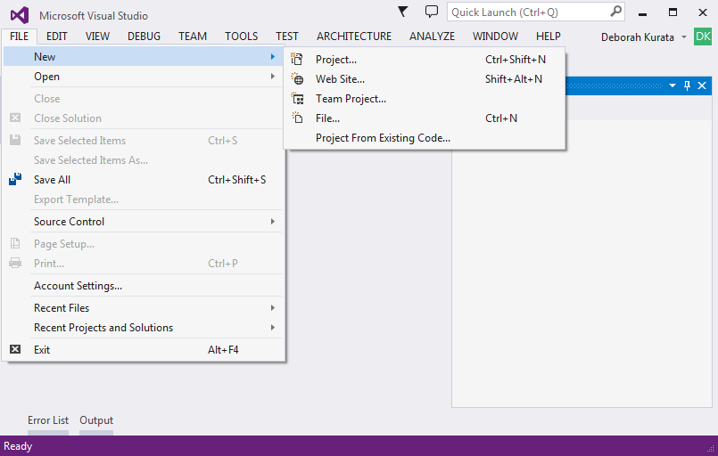
Creating an Angular Project

Slide 42
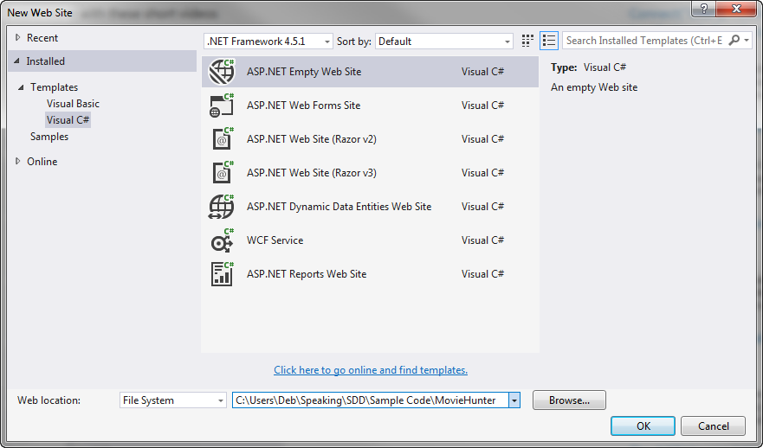
Selecting a Template

Slide 43
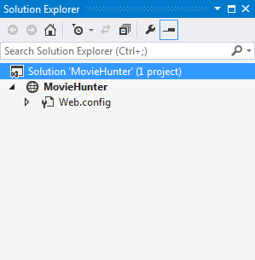
Generated Solution

Slide 44
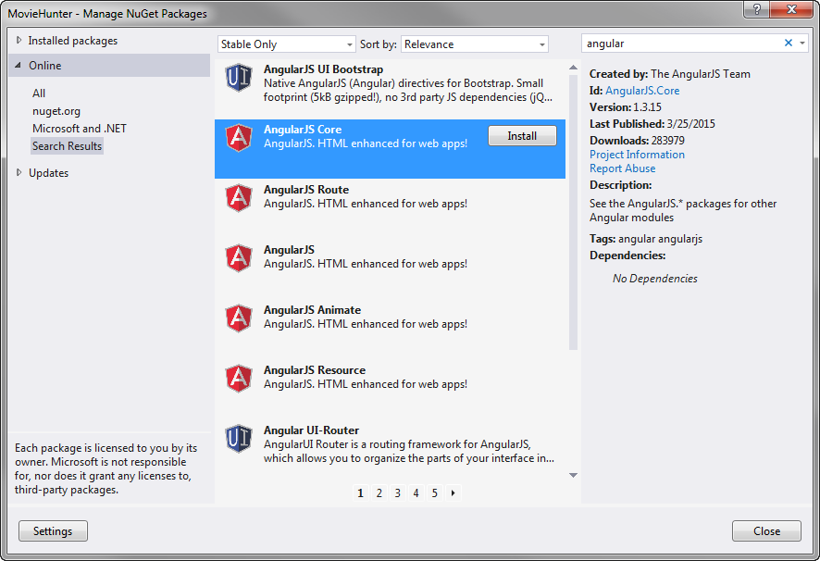
NuGet Package Manager

Slide 45
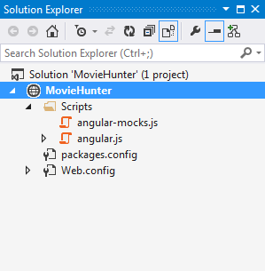
Solution Explorer

Slide 46
app.js (movieHunter)
index.html
movieListView.html
<head>
<link …/>
</head>
<body ng-app=
"movieHunter">
<div ng-controller=
"MovieListCtrl as vm">
...
</div>
movieListCtrl.js (MovieListCtrl)
[menu code here]
<ng-include=
"'movieListView.html'">
Model
<script …/>
</body>
Methods

Slide 47
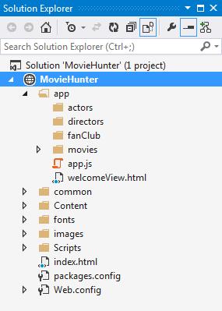
Project Structure
Provides order
Supports multiple developers
Simplifies Maintenance
By Feature

Slide 48
Angular Style Guide
https://github.com/johnpapa/angular-styleguide

Slide 49
DEMO: Hands on Lab 1
Notes:
TAKE 2
- F12 tools

Slide 50
Session Materials & Sample Code
https://github.com/DeborahK/angularu2015

Slide 51
Hands On Lab 1: Basics
Add the script tags
Add the director to the HTML table
Create the module
Create the controller
Run the application
Notes:
Take 1

Slide 52
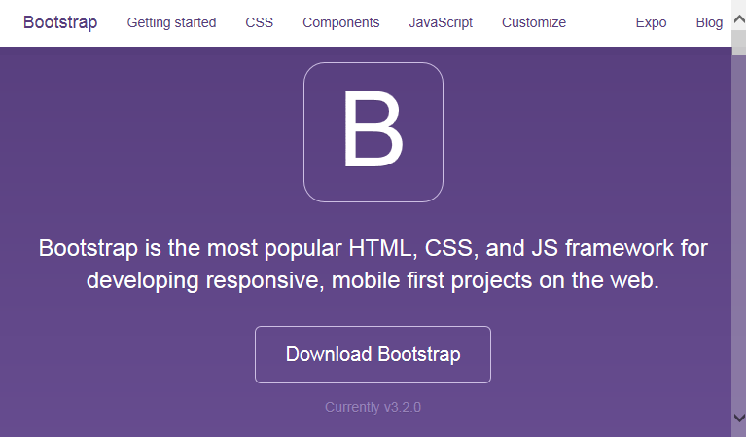
Bootstrap
http://getbootstrap.com
Framework for prettifying Web pages
Developed by Twitter
Large third party community
Notes:
Responsive
Browser Differences

Slide 53
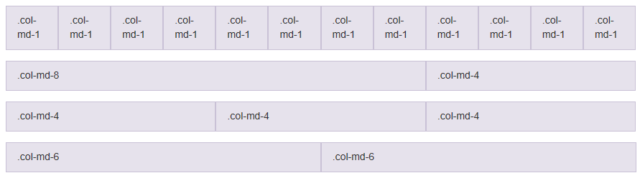
Bootstrap Grid System
Notes:
Responsive
Browser Differences

Slide 54
Bootstrap Style Classes
<div class="panel panel-primary">
<div class="panel-heading">
<h2 class="title">{{vm.title}}</h2>
</div>
<div class="panel-body">
<!-- Filter the Title -->
<div class="row">
<div class="col-md-2">Filter by:</div>
<div class="col-md-4"> <input type="text" ng-model="listFilter" />
</div>
</div>
. . .

Slide 55
DEMO: Hands On Lab 2

Slide 56
Hands On Lab 2: Bootstrap
Two options: Examine vs Type
Add the link tag
Examine the class attributes
Run the application

Slide 57
Review - Basics
Introduction to Angular
Angular and HTML: Building a View
Data Binding
Angular Code: Building the Module & Controller
Bootstrap: Styling the View
Notes:
- AngularUI if time permits.

Slide 58
Routing

Slide 59
Rate Yourself on Routing
New to Angular - no proficiency
Just starting out - limited proficiency
Doing it but not fully understanding it - working proficiency
Been there, done that, can help others - full proficiency

Slide 60
Overview - Routing
Introduction to SPA
Rule-Based Navigation / Routing
Routing Frameworks
Defining Routes (ngRoute)
Navigating Routes (ngRoute)

Slide 61
Demo: Angular in Action
Notes:
Product Management
Point out how the navigation works.
And how the nested views look.
2) Movie Hunter - Take 4
Point out the simple navigation.
This is the code we will look at in this session

Slide 62
app.js (movieHunter)
index.html
movieListView.html
<head>
<link …/>
</head>
<body ng-app=
"movieHunter">
<div ng-controller=
"MovieListCtrl as vm">
...
</div>
movieListCtrl.js (MovieListCtrl)
[menu code here]
<ng-include=
"'movieListView.html'">
Model
<script …/>
</body>
Methods
Notes:
Remember what our app looks like at this point?

Slide 63
SPA
Single Page Application
Only one page?
Only one full HTML page
All other pages are HTML fragments called templates
And are displayed within the one HTML page
Goals:
Enhance user experience
Reduce round tripping
Notes:
"Template" or sometimes "layout template"

Slide 64

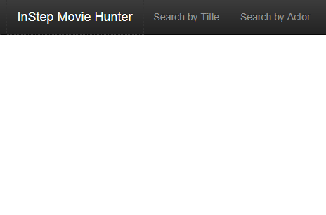
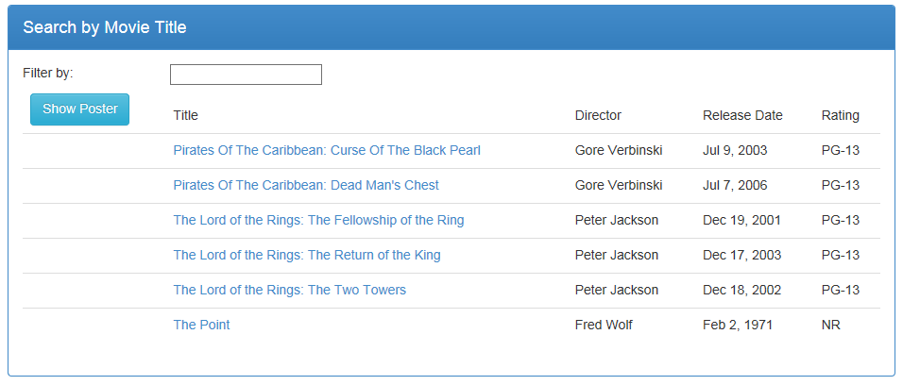
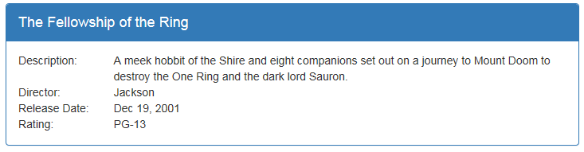
Multiple Views
Notes:
Most Web applications are more than one page.
- Define each view in its own html file.
Define the header, menu, footer in the index.html.
Define the ng-view directive in the location in the HTML where the views should appear.

Slide 65
Routing
Rule-based Navigation
Technique for navigating between views
Each route represents a specific view
Activating a route navigates to that view
Routes defined by rules

Slide 66
Site Map
Welcome Page
Movie Detail
Movie List
Menu
Movie Edit
Notes:
An easy way to picture the routing is to look at a site map.

Slide 67
Routes
Welcome Page
/showDetail/3
Movie Detail
/
/searchByTitle
Movie List
/editMovie/3
Menu
Movie Edit
/editMovie/0
Notes:
Each view in the map can then be associated with a named route.

Slide 68
Routing URL Fragments
<mysite>/index.html#/
<mysite>/index.html#/searchByTitle
<mysite>/index.html#/showDetail/3
Notes:
Define the ng-view directive in the location in the HTML where the views should appear.
ng-viewport in the new Angular router.
Why the hash tags?

Slide 69
Routing Frameworks
ngRoute
UI Router
ngNewRouter
Notes:
ngRoute
Is the original routing framework provided by Angular.
It provides for simple, straight-forward routes.
UI Router
Is a third-party routing package.
It has more advanced features than ngRoute including
Nested views, as we saw with the tab pages in the Product Management application we looked at.
ngNewRouter
Is the new router that is coming out in Angular 1.4
And is expected to be the router for Angular 2.0.
It provides the ease of use of ngRoute
With many of the more advanced features from UI Router.
Though the syntax will be slightly different, the concepts are the same for each of the three frameworks

Slide 70
Setting Up Routing: ngRoute
Define where each view should appear
Set up the routing rules:
Path, associated view, associated controller
Navigate by activing a route

Slide 71
ngRoute: index.html
<div class="container">
<div ng-view></div>
</div>
Notes:
- By convention, the "single page" of the application is defined in index.html.
- In the index.html file, define the header, menu bar, and footer.
- And use the ng-view directive to identify where the HTML templates for the views should appear.
ng-view includes the rendered template of the current route into the main layout.
Every time the route changes, the included view changes with it according to the route configuration.

Slide 72
Routes
Welcome Page
/showDetail/3
Movie Detail
/
/searchByTitle
Movie List
Menu
Movie Edit
/editMovie/3

Slide 73
ngRoute: app.js
var app = angular.module("movieHunter", ["ngRoute"]);
app.config(['$routeProvider',
function ($routeProvider) {
$routeProvider
.when("/", {
templateUrl: "app/welcomeView.html"
})
.when("/searchByTitle", {
templateUrl: "app/movies/movieListView.html",
controller: "MovieListCtrl as vm"
})
.when("/showDetail/:movieId", {
templateUrl: "app/movies/movieDetailView.html",
controller: "MovieDetailCtrl as vm"
})
.otherwise("/");
}]);
Notes:
$routeProvider is the provider for the $route service.
Providers create and provide instances of services and expose configuration APIs.
Providers can only be injected into config functions.
Everyone know what "controller as" means?
NOTE: I cut the edit view off of this code so it would fit in the slide.

Slide 74
Navigating Routes
Anchor tags
Link to the appropriate route
<a ng-href="#searchByTitle">
$location service
$location.path("/searchByTitle");
Notes:
To navigate to a view, activate its route.

Slide 75
ngRoute: index.html
<div class="navbar-collapse collapse">
<ul class="nav navbar-nav">
<li>
<a ng-href="#searchByTitle">Search by Title</a>
</li>
</ul>
</div>

Slide 76
ngRoute: movieDetailView.html
<div class="panel-footer">
<a class="btn btn-default"
ng-href="#searchByTitle"
style="width:80px">
<i class="glyphicon glyphicon-chevron-left"></i>
Back
</a>
</div>

Slide 77
Demo: Hands On Lab 3
Notes:
Show the app.js file.
Show the index.html file
Show the movieDetailView.html file.
Show the movieEditView.html file.

Slide 78
Hands On Lab 3: Routing
Add the script tags
Replace ng-include with ng-view
Add ngRoute as a dependency
Examine the routing code!
Add the ng-href to activate the #searchByTitle route to return from the movieDetailView page
Run the application

Slide 79
Review - Routing
Introduction to SPA
Rule-Based Navigation / Routing
Routing Frameworks
Defining Routes (ngRoute)
Navigating Routes (ngRoute)

Slide 80
Data Access

Slide 81
Rate Yourself on Data Access
New to Angular - no proficiency
Just starting out - limited proficiency
Doing it, not fully understanding it - working proficiency
Been there, done that, can help others - full proficiency

Slide 82
Overview – Data Access
Request/Response Flow
JavaScript Promises
Retrieving Data via HTTP Service
Reusable Code: Building a Service

Slide 83
Web Browser
Web Server
URL Request (www.mysite.com)
HTML
HTML
Response (Page and Assets)
Java-Script
Java-Script
HTTP Service
DB
Notes:
So, how does it work.
There are no "Angular" files per se.
Index.html by convention is the startup page.
It contains link and script tags with the paths to the required assets (HTML templates, JavaScript files, CSS files, etc)

Slide 84
Web Browser
Web Server
HTML
URL Request (www.mysite.com)
HTML
Response (Page and Assets)
Java-Script
Java-Script
(http://mysite/api/movies)
HTTP Service
Response
DB
Data

Slide 85
Retrieving Data
HTTP Service
GET Request
api/movies
Notes:
Let's look at this same process from a different perspective.
Request is asynchronous, so the user could select a different option or close the browser.

Slide 86
Retrieving Data
HTTP Service
GET Request
api/movies
Response
[
{ director: "Peter Jackson",
movieId: 1,
mpaa: "pg-13",
releaseDate: "2001-12-19T00:00:00",
title: "The Lord of the Rings: The Fellowship of the Ring"
},
{ director: "Peter Jackson",
movieId: 2,
mpaa: "pg-13",
releaseDate: "2002-12-18T00:00:00",
title: "The Lord of the Rings: The Two Towers"
},
...
]

Slide 87
JavaScript Promise
Launch an asynchronous operation
Up to 3 Callback Functions
Async Operation
Return immediately
As the operation progresses …
When the operation is complete
If the operation is successful …
If the operation fails …

Slide 88
Calling HTTP Service
$http
$resource
$httpBackend
Notes:
$httpBackend
Angular's fake HTTP backend implementation
Mocks calls to the HTTP service
Returns static data to the application

Slide 89
$http
$http.get("/api/movies/")
.success(function(response) {
vm.movies = response.data;
});
Built into Angular Core
Facilitates communication with a back-end service get, post, put, delete, …
Asynchronous
Notes:
When the request is complete:
The callback function is executed
The response object is passed in
Define the callback functions
Success
Error

Slide 90
REST
REpresentational State Transfer
Requests and responses involve the transfer of resources
Resources are identified with a URL
/api/movies/
Requests utilize a standard set of HTTP verbs
GET | POST | PUT | DELETE
And much more!

Slide 91
$resource
function movieResource($resource) {
return $resource("/api/movies/:movieId")
}
Separate Angular component: angular-resource ngResource
Abstraction on top of $http for calling RESTful services
Requires less code
Notes:
When the request is complete:
The callback function is executed
The response object is passed in

Slide 92
Reusable Data Access Service
Angular module
(common.services)
Angular module
(movieHunter)
Custom Angular service
(movieResource)
View
(movieList View)
Angular controller
(MovieListCtrl)
HTTP Service
Built in $resource service
Model
Methods
Notes:
Let's zoom in on the movieResource service

Slide 93
Module: common.services
(function () {
"use strict";
angular
.module("common.services",
["ngResource"])
.constant("appSettings",
{
serverPath : "http://localhost:1561"
});
}());

Slide 94
Service: movieResource
(function () {
"use strict";
angular
.module("common.services")
.factory("movieResource",
["$resource",
"appSettings",
movieResource]);
function movieResource($resource, appSettings) {
return $resource(appSettings.serverPath + "/api/movies/:id");
}
}());

Slide 95
Built-In $resource Methods
Angular module (common.services)
movieResource service
$resource service
Query
Get
Save
HTTP Service
GET Request
api/movies
GET Request
api/movies/5
POST Request
api/movies
Notes:
Query -> Array
Get -> Single item

Slide 96
$resource Methods
Method Name | Verb | URL | Description
query | GET | /api/movies | Retrieves all of the movies
get | GET | /api/movies/5 | Retrieves the specified movie
save | POST | /api/movies | Saves modifications to the movie
movieResource.query(function (data) {
vm.movies = data;
});
movieResource.get({ movieId: $routeParams.movieId },
function (data) {
vm.movie = data;
});
Notes:
Notice that both of these methods are called using the service "class".

Slide 97
$resource Methods (cont)
Method Name | Verb | URL | Description
query | GET | /api/movies | Retrieves all of the movies
get | GET | /api/movies/5 | Retrieves the specified movie
save | POST | /api/movies | Saves modifications to the movie
vm.movie.$save(function (data) {
vm.message = "Save successful.";
});
Notes:
This method is called using the instance.

Slide 98
Using movieResource
(function () {
"use strict";
angular
.module("movieHunter")
.controller("MovieListCtrl",
["movieResource",
MovieListCtrl]);
function MovieListCtrl(movieResource) {
var vm = this;
vm.movies = [];
vm.title = "Search by Movie Title";
vm.showImage = false;
. . .

Slide 99
Using movieResource (cont)
vm.toggleImage = function () {
vm.showImage = !vm.showImage;
};
movieResource.query(
function (data) {
vm.movies = data;
});
}
}());

Slide 100
Data Access
HTTP Service
GET Request
api/movies
Notes:
Let's look at this same process from a different perspective.
Request is asynchronous, so the user could select a different option or close the browser.

Slide 101
Data Access
HTTP Service
GET Request
api/movies
Response
[
{ director: "Peter Jackson",
movieId: 1,
mpaa: "pg-13",
releaseDate: "2001-12-19T00:00:00",
title: "The Lord of the Rings: The Fellowship of the Ring"
},
{ director: "Peter Jackson",
movieId: 2,
mpaa: "pg-13",
releaseDate: "2002-12-18T00:00:00",
title: "The Lord of the Rings: The Two Towers"
},
...
]

Slide 102
Mocking Data Access
api/movies
Mocking Service
HTTP Service
Notes:
Let's look at this same process from a different perspective.
Request is asynchronous, so the user could select a different option or close the browser.

Slide 103
Mocking Data Access
api/movies
Mocking Service
HTTP Service
GET Request
api/movies
[
{ director: "Peter Jackson",
movieId: 1,
mpaa: "pg-13",
releaseDate: "2001-12-19T00:00:00",
title: "The Lord of the Rings: The Fellowship of the Ring"
},
...
]
Notes:
Let's look at this same process from a different perspective.
Request is asynchronous, so the user could select a different option or close the browser.

Slide 104
$httpBackend
Angular’s fake HTTP backend implementation
Mocks the calls to the Web Service
Returns static data to the application
Two implementations:
ngMock: for unit testing applications
ngMockE2E: for end-to-end testing or backend-less development

Slide 105
Steps to Mocking the Web Server
Create a new module that depends on ngMockE2E
Add the new module as a dependency in the Main Module
Define the fake responses to the Web Service calls
Set up static data
Notes:
ngMockE2E is contained in angular-mocks.js that is downloaded with angular core.

Slide 106
Demo: Hands On Lab 4
Notes:
Show the app.js file.
Show the index.html file
Show the movieDetailView.html file.
Show the movieEditView.html file.

Slide 107
Hands On Lab 4: Data Access
Add the script tags
Add a dependency on the new modules
Examine the new movieResource service
Inject the service into the movieListCtrl
Call the $resource query method
Inject the service into the movieDetailCtrl
Call the $resource get method
Run the application

Slide 108
Review – Data Access
Request/Response Flow
JavaScript Promises
Retrieving Data via HTTP Service
Reusable Code: Building a Service

Slide 109
Forms & Validation

Slide 110
Rate Yourself on Forms and Validation
New to Angular - no proficiency
Just starting out - limited proficiency
Doing it but not fully understanding it - working proficiency
Been there, done that, can help others - full proficiency

Slide 111
Overview – Forms & Validation
Building a Data Entry Form
Performing Validation
Setting Validation Styles
Displaying Validation Messages

Slide 112
Demo: Forms and Validation
Notes:
Product Management
Point out the validation of the form.
2) Movie Hunter
Point out the validation.
This is the code we will look at in this session

Slide 113
Creating a Form
<form name="movieForm">
<fieldset>
<legend>Edit Movie Information</legend>
</fieldset>
</form>
It's just HTML
Notes:
When the request is complete:
The callback function is executed
The response object is passed in

Slide 114
Adding Controls to a Form
<div>
<label for="inputMovieTitle">
Movie Title</label>
<input id ="inputMovieTitle“
type="text"
placeholder="Movie Title" />
</div>
<div>
<label for="inputDescription">
Description</label>
<textarea id="inputDescription“
placeholder="Description"
rows="3" />
</div>
Notes:
More HTML
Id is used for matching with the label.
How do you get data onto the form?

Slide 115
Data Binding
One-Way Binding
View is the projection of the model
When the model changes, the view reflects the change
Two-Way Binding
View and model data are synchronized
Changes to the model are reflected in the view
Changes in the view are reflected in the model

Slide 116
One-Way Binding
movieHunter
movieListView
MovieListCtrl
<div>
Binding
{{vm.title}}
Model
</div>

Slide 117
Two-Way Binding
movieHunter
movieEditView
MovieEditCtrl
<form name="movieForm">
<input
name=inputMovieTitle
Directive
ng-model = "vm.movie.title"
Model
/>
</form>

Slide 118
Two-Way Binding
<div>
<label for="inputMovieTitle">
Movie Title</label>
<input id ="inputMovieTitle“
type="text"
placeholder="Movie Title" />
</div>
<div>
<label for="inputDescription">
Description</label>
<textarea id="inputDescription“
placeholder="Description"
rows="3" />
</div>
Notes:
More HTML
Id is used for matching with the label.
How do you get data onto the form?

Slide 119
Two-Way Binding
<div>
<label for="inputMovieTitle">
Movie Title</label>
<input id ="inputMovieTitle“
type="text"
placeholder="Movie Title"
ng-model="vm.movie.title" />
</div>
<div>
<label for="inputDescription">
Description</label>
<textarea id="inputDescription“
placeholder="Description"
rows="3"
ng-model="vm.movie.description" />
</div>
Notes:
More HTML
Name is used by Angular
Id is used for matching with the label.
How do you get data onto the form?

Slide 120
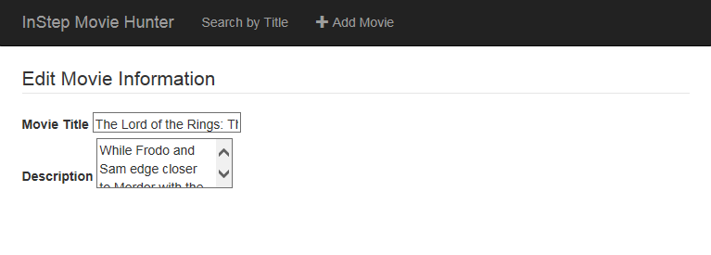
The Result
Notes:
That does not look very nice!
Bootstrap to the rescue!

Slide 121
Bootstrap Styles
<div class="form-group">
<label class="col-md-2 control-label" for="inputMovieTitle">
Movie Title</label>
<div class="col-md-6">
<input class="form-control"
id ="inputMovieTitle"
type="text"
placeholder="Movie Title"
ng-model="vm.movie.title" />
</div>
</div>
Notes:
Bootstrap classes

Slide 122
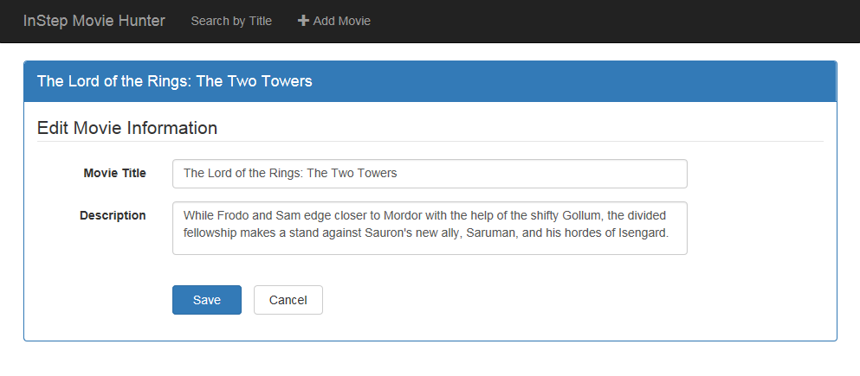
The Result
Notes:
MUCH BETTER!

Slide 123
Demo: Hands On Lab 5-1

Slide 124
Hands On Lab 5: Forms
Add the script tags
Add an editMovie route for the movieEditView
Run the application
Add a label and input box for the movie director
Run the application

Slide 125
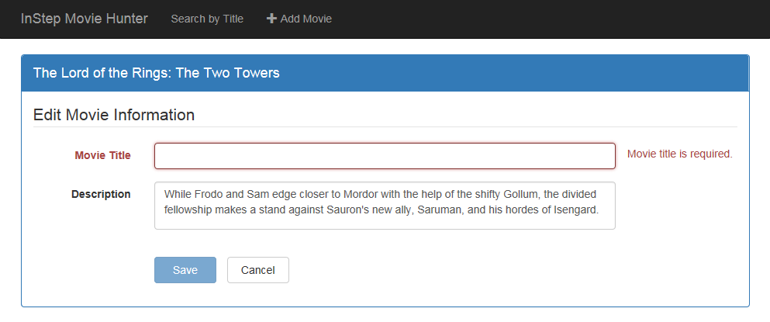
Validation
Notes:
Notice the color change and the associated message text.
Also notice that the Save button is now disabled.

Slide 126
Prepare the form
Ensure the form has a name
Set the novalidate attribute
<form class="form-horizontal"
name="movieForm">
<form class="form-horizontal"
name="movieForm"
novalidate>

Slide 127
Angular Validation Techniques
Type Attribute
type="email"
Required Attribute
required
HTML Validation Attributes
min = "1"
Angular Validation Attributes
ng-minlength = "3"
Custom Angular Directive
my-directive=""
Notes:
Type Attribute (standard HTML 5 validators): email, tel, url, number, etc
ng-minlength, ng-maxlength, ng-pattern
Custom Angular Validation possible, but not covered.
Expanded validation
Cross-field validation
Asynchronous validation

Slide 128
Validation Attributes
<div class="col-md-8">
<input class="form-control"
id="inputMovieTitle"
name="inputMovieTitle"
type="text"
placeholder="Title (required)"
ng-model="vm.movie.title"
required
ng-minlength="3"
ng-maxlength="50" />
</div>
Notes:
First, ensure the control has a name. The validation uses the name.
Second, set the desired validation attributes

Slide 129
Marking Invalid Elements
ngClass Directive
Angular Validation States
Bootstrap Style
<div class="form-group"
ng-class="{'has-error': movieForm.inputMovieTitle.$invalid && movieForm.inputMovieTitle.$dirty}">
</div>
Notes:
ng-class defines the style class
'has-error' is the bootstrap style
movieForm -> name of the form
inputMovieTitle -> name of the control
$invalid -> Angular validation state
$dirty -> Prevents display of the message until the user has edited the field.

Slide 130
Angular Validation States
$pristine
Value has not been changed
$dirty
Value has been changed
$valid
Value is valid
$invalid
Value is invalid
$error
All validations and whether they are valid or invalid

Slide 131
Angular Validation States (New in 1.3)
Control never "touched" (blur)
$untouched
Control was "touched" (on blur)
$touched
Notes:
Blur => lost focus
Good for validation when the user enters a required field but does not change it.

Slide 132
Demo: Hands On Lab 5-2
Notes:
Show the movieEditView.html file.
Run
Demo the Edit page + Validation
Demo the Add page + Validation
Notice that the Star Rating message appears immediately, before the user has a chance to type.
Demonstrate the difference between ng-if="….required" vs "….touched"

Slide 133
Hands On Lab 5: Validation
Use attributes to define appropriate validation rules
Add the ng-class attribute to set the validation color coding
Run the application

Slide 134
Validation Messages
Notes:
But changing the style is not enough. We also want to display a message.

Slide 135
ngMessages: New in 1.3
Requires
angular-messages
ngMessages
ng-Messages
Shows or hides messages
ng-Message
Defines specific cases
Similar to a switch or case statement
<span class="help-block">
<span ng-messages="movieForm.inputMovieTitle.$error">
<span ng-message="required">Movie title is required</span>
<span ng-message="minlength">Must be at least 3 characters</span>
<span ng-message="maxlength">Cannot exceed 50 characters</span>
</span>
</span>

Slide 136
Form Group
<div class="form-group"
ng-class="{'has-error':movieForm.inputMovieTitle.$invalid &&
movieForm.inputMovieTitle.$dirty}">
<label class="col-md-2 control-label"
for="inputMovieTitle">Movie Title</label>
<div class="col-md-8">
<input class="form-control"
id="inputMovieTitle“ name="inputMovieTitle"
type="text’ placeholder="Title (required)"
ng-model="vm.movie.title required ng-minlength="3“ ng-maxlength="50" />
</div>
<span class="help-block“ ng-if="movieForm.inputMovieTitle.$dirty">
<span ng-messages="movieForm.inputMovieTitle.$error">
<span ng-message="required">Movie title is required</span>
<span ng-message="minlength">Movie title must be at least 3 characters</span>
<span ng-message="maxlength">Movie title cannot exceed 50 characters</span>
</span>
</span>
</div>
Notes:
Let’s put it into context.

Slide 137
Demo: Hands On Lab 5-3
Notes:
Show the movieEditView.html file.
Run
Demo the Edit page + Validation
Demo the Add page + Validation
Notice that the Star Rating message appears immediately, before the user has a chance to type.
Demonstrate the difference between ng-if="….required" vs "….touched"

Slide 138
Hands On Lab 5: Messages
Add the script tag for angular-messages
Add a dependency on ngMessages
Add validation messages
Run the application

Slide 139
Review – Forms & Validation
Building a Data Entry Form
Performing Validation
Setting Validation Styles
Displaying Validation Messages

Slide 140
Take Away
Expressive HTML
Powerful Data Binding
Modularity
Rule-based Navigation
Easily Call HTTP Service
Authoritative Forms

Slide 141
Thank You!
deborahk@insteptech.com
jerryk@insteptech.com
@deborahkurata
http://blogs.msmvps.com/deborahk
https://github.com/DeborahK/angularu2015

